Slide 1
Web App
Filters
Show/Hide Dimensions
Load Existing Scenarios:
(single-select)
Start New Scenario:
Data Source:
(Multi-select)
Minor Category:
(multi-select)
Brands:
(multi-select)
Roll Ups:
(multi-select)
Years:
(multi-select)
Measure:
(single-select)
 Scenario 1
Scenario 2
Scenario 3
Scenario 4
…
Provide Scenario Name
 IRI
Costco
eComm
Bar Soap
Body Wash
Baby Cleansing
Bath Additives
Dove
Dove M+C
Suave
Caress
…
Quarter MAT
Half MAT
Full Year
 2020
2021
2022
 $ Sales CATEGORY
% Chg CATEGORY
$ Sales UNILEVER
% Chg UNILEVER
UL $ Share
Publish Scenario
>
Persistent Views (Calculated based on user inputs below):
*Multi Selecting Data Source will calculate aggregated totals
Incl Elida
Excl Elida
Body Cleansing
Incl Elida
Excl Elida
Bar Soap
FY MAT H1 MAT Q1 MAT Q1 MAT Q3 MAT Q4 MAT
FY MAT H1 MAT Q1 MAT Q1 MAT Q3 MAT Q4 MAT
Based on Filters: Separate views for Data Sources
Body Cleansing (Category Total)
IRI
*Roll Ups Filter to toggle whether to see or not
Costco
*Roll Ups Filter to toggle whether to see or not
Views below update based on Filters(Calculated based on user inputs below):
Bar Soap (Minor Category Total)
User input 1: Alter Category Forecast for Minor Categories
IRI
Costco
Bar Soap Brands (Minor Category Brands)
IRI
User input 2: Alter Forecast for Brands
Costco

Slide 2
PowerBi?
Filters
Show/Hide Dimensions
Scenarios:
(single-select)
Data Source:
(multi-select)
Measure:
(single-select)
Product:
(single-select)
Forecast Periods:
(multi-select)
 Scenario 1
Scenario 2
Scenario 3
Scenario 4
…
 IRI
Costco
eComm
 POS Growth
$ Share
Bps Chg
 TTL Unilever
Unilever excl Elida
Unilever excl Suave
Monthly
Quarter MAT
Half MAT
 | Current Year |  |  |  | Forecasts
UL Product | L4 | L12 | YTD | 52wk MAT | H1 MAT | Full Year
Body Cleansing
Brand 1
Brand 2
Brand 3
Brand 4
Bar Soap
Brand 1
Brand 2
Brand 3
Brand 4
Body Wash
Brand 1
Brand 2
Brand 3
Brand 4
Baby Cleansing
Brand 1
Brand 2
Brand 3
Brand 4
Bath Additives
Brand 1
Brand 2
Brand 3
Brand 4
Data Reference:
IRI Unify Update Through:
Costco Update Through:
eComm Update Through:

Slide 3
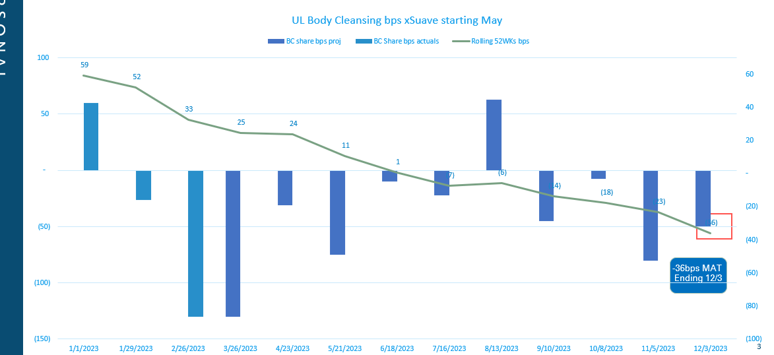
PowerBi?
Filters
Scenarios:
(single-select)
Data Source:
(multi-select)
Product:
(single-select)
Minor Category:
(multi-select)
Brands:
(multi-select)
 Scenario 1
Scenario 2
Scenario 3
Scenario 4
…
 IRI
Costco
eComm
 TTL Unilever
Unilever excl Elida
Unilever excl Suave
Bar Soap
Body Wash
Baby Cleansing
Bath Additives
Bar Soap
Body Wash
Baby Cleansing
Bath Additives
Data Reference:
IRI Unify Update Through:
Costco Update Through:
eComm Update Through:

Slide 4
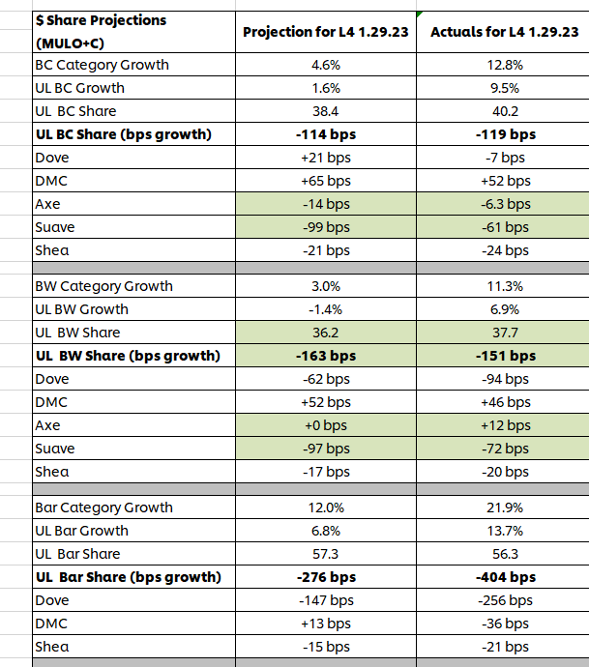
PowerBi?
Filters
Scenarios:
(single-select)
Data Source:
(multi-select)
Measure:
(single-select)
Product:
(single-select)
Minor Category:
(multi-select)
Brands:
(multi-select)
 Scenario 1
Scenario 2
Scenario 3
Scenario 4
…
 IRI
Costco
eComm
 POS Growth
$ Share
Bps Chg
 TTL Unilever
Unilever excl Elida
Unilever excl Suave
Bar Soap
Body Wash
Baby Cleansing
Bath Additives
Bar Soap
Body Wash
Baby Cleansing
Bath Additives
Brand Projections
Data Science Projections
Data Reference:
IRI Unify Update Through:
Costco Update Through:
eComm Update Through:

